Slide 1
Twitter Sentiment Analysis
(Sentiment140 dataset with 1.6 million tweets)

Slide 2
Introduction
Sentimental Analysis is a process of ‘computationally’ determining whether a piece of writing is positive or negative.
In this project I used twitter sentiment data to analyse emotions based on the text and using natural language processing. Our database includes 1.6 million tweets and each one is labeled as negative or positive. (99578 negative tweets and 99513 positive tweets). I Split the training set and the test set in 80/20 ratio.

Slide 3
Steps Involved In Classifying Setimental Analysis
Dataset Observation
Data Cleaning
Exploratory Analysis
Data Preprocessing
Classifying tweets to negative and positive words using various Machine Learning algorithms.

Slide 4
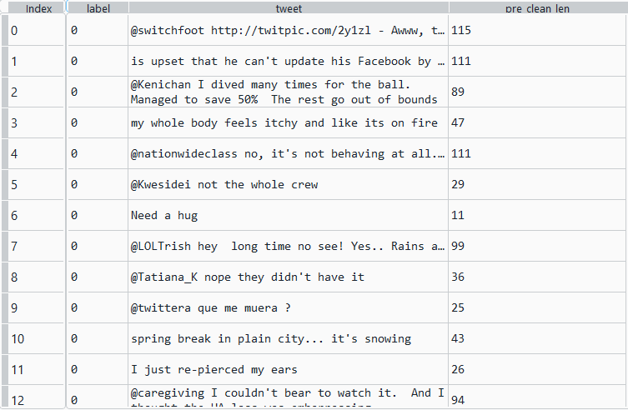
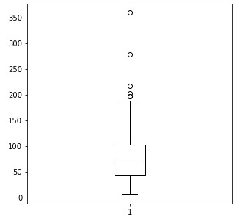
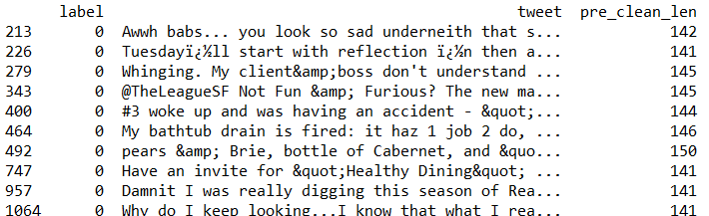
Data Observations
Box plot of tweets length
Since twitter has characters limitation of 140, check why there are tweets more than 140 characters:

Slide 5
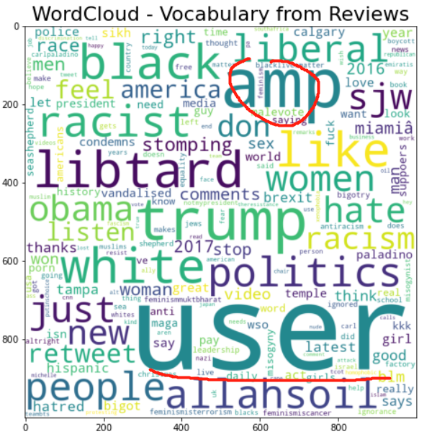
Dataset observation on word counts

Slide 6
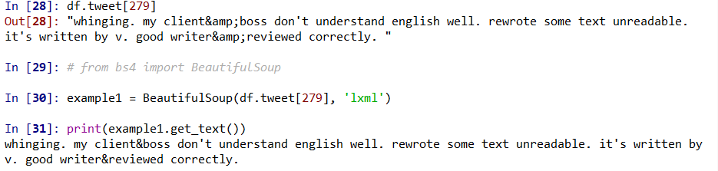
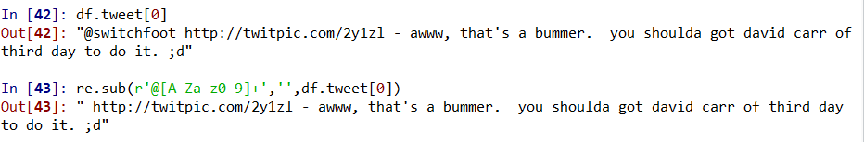
Cleaning the data
Filter out the empty cells! - 199276 tweets left
Making statement text in lower case
HTML decoding for ‘&amp’ , ‘&quot’ etc.‘
Removing URL Links and ‘@’ user:

Slide 7
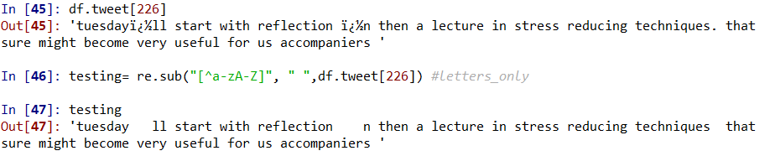
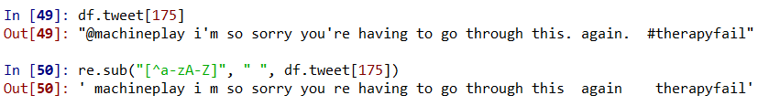
Cleaning the data:
Removing Encoding Errors:
Removing hashtag / numbers:

Slide 8
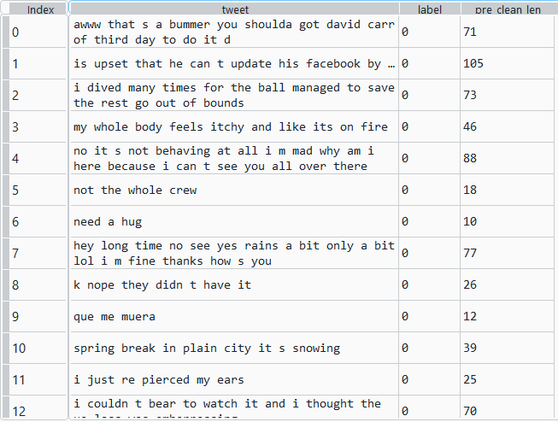
Data Results After and Before Cleaning
Original:
Format cleaning:

Slide 9
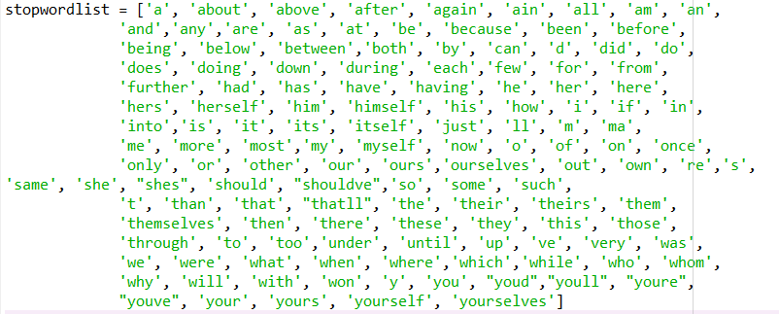
More cleaning on the words level:
Defining set containing all stopwords in English.
To clear the Personal Pronoun, ‘the’, and other common words that with no meanings.
Removing short words that are less than 1 letter (I feel ‘hmm’ and ‘oh’ may be useful for the test, so I am going to keep them):

Slide 10
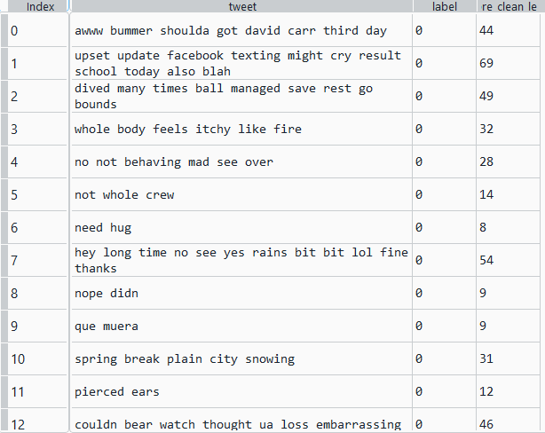
Data Cleaning on word level:
Format cleaning:1
Format cleaning 2

Slide 11


Detection of Meaningless Words
Removing words : 'day','today','got','going','time','im','think','one','think','know’, ‘twitter’

Slide 12


Removing meaningless words

Slide 13
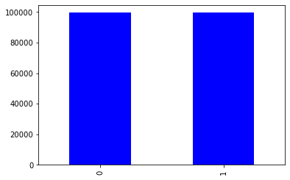
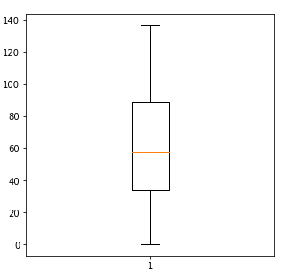
Exploratory Analysis
Total number of tweets: 199091
Total number of words :77692
Data is not skewed as I have equal numbers of negative and positive tweets.
Box plot of string length:
there are no text more than 140 characters.

Slide 14
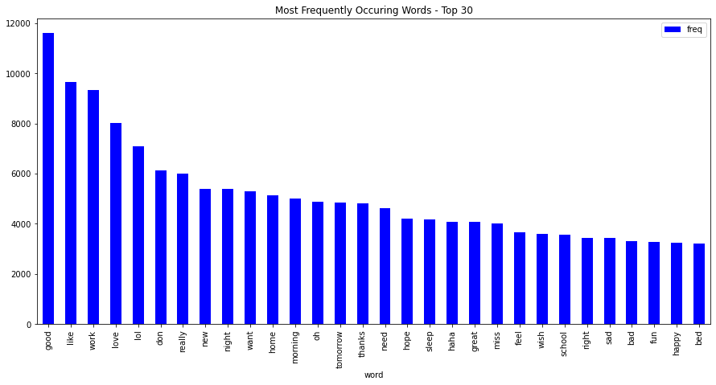
Exploratory Analysis
Top 30 most frequency words in the data using Count Vectorize method

Slide 15
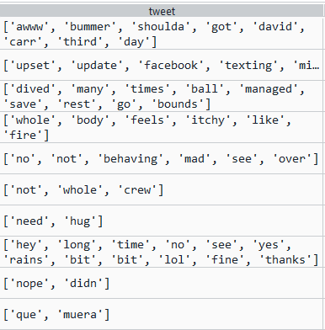
Preparation Data for Classification
Do Word Tokenization (splitting a piece of a text into individual word based on a certain delimiter )
Applying Stemming (to make all the format of words uniformed, remove e.g “ing”, “s”, “ed”… )
Applying Lemmatization (morphological analysis )

Slide 16
Feature Extractions-2500 Features
One-Hot method :
Text data representation: (frequency is 0 or 1)
CV Method :
Transform a given text into a vector on the basis of the frequency (count) of each word that occurs in the entire text.
TF-IDF (term frequency–inverse document frequency) Method :
Evaluates how relevant a word is to a document in a collection of documents, the value is not an integer.
Notes:
# min_df=2: ignore terms that appear in more than 90% of the documents
# max_df=0.90: only keep terms that appear in at least 2 documents
# # include 1-grams and 2-grams
This step I vectorized the text. I create a bag of words, the bag contains 2500 features (it has around 77k words totally), it ignore terms that appear in more than 90% of the documents, and only keep terms that appear in at least 2 documents
There are three types of data representations. One hot generate the 2500 features depends on the most frequent word. It will count the word if the certain word appears in the tweet, for example if I see a word “NLP” in a tweet, it will marked as 1, otherwise 0. It will not count the frequency of the word appears twice in a tweet
CV is very similar with one hot, it generate the 2500 features depends on the most frequent word. but it will count the frequency of each word that occurs in the entire text.
TF IDF will generate the features depending on the importance of the word, not frequency, and it will generate a number as the importance of the word

Slide 17
Appling ML Models
Naive Bayes
BernoulliNB
MultiNomialNB
K- Nearest Neighbour
CART (Classification and Regression Tree)
Random Forest
Logistic Regression
With PCA and without PCA
Using L1 and L2 Regularization with SAG and SAGA Optimizations
Neural Network
With PCA and without PCA
Notes:
I am using each of one-hot, cv, and tf-idf text representation (feature extraction) method to do a BernoulliNB and MultinomialNB comparison as these two models are most common in NLP.

Slide 18
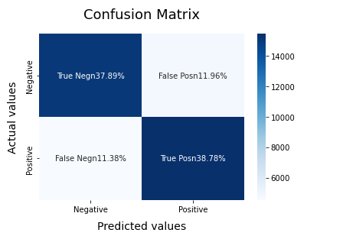
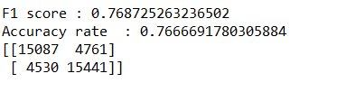
Naive Bayes:
Results:
One-hot (frequency is 0 or 1):
Bernoulli NB using alpha=0 accuracy rate=0.7553
Bernoulli NB using alpha=1 accuracy rate=0.7553
Multinomial NB accuracy rate=0.7501
Cv:
Bernoulli NB using alpha=0 accuracy rate=0.7550
Bernoulli NB using alpha=1 accuracy rate=0.7550
Multinomial NB accuracy rate=0.7490
TF-IDF:
Bernoulli NB using alpha=0 accuracy rate=0.7667
Bernoulli NB using alpha=1 accuracy rate=0.7667
Multinomial NB accuracy rate=0.7602
Notes:
I am using each of one-hot, cv, and tf-idf text representation (feature extraction) method to do a BernoulliNB and MultinomialNB comparison as these two are most common in NLP.
Although using multinomial for binary classification is not recommended, I still want to see the different
To Bernoulli Naive Bayes, the one hot representation is slightly higher than the CV, as it only shows 0 and 1.

Slide 19
Naive Bayes Result:
It seems TF-IDF works better for Naive Bayes.
One-hot and CV works better for Bernoulli NB than Multinomial NB which makes sense as each tweet is short, and most of the frequency in this dataset is 0 or 1.
Bernoulli NB works slightly better than Multinomial NB.
Now having a baseline of a 0.7667 accuracy. Using Bernoulli NB with TF-IDF feature extraction.
Notes:
TF-idf works better as TF -idf depending on the importance of the word and cv depending on the frequency, it makes sense TF IDF works better.
bernoulli works better for short text as the one word seldom appears twice in a tweet
TF -idf works to Bernoulli as the features will be binarized

Slide 20
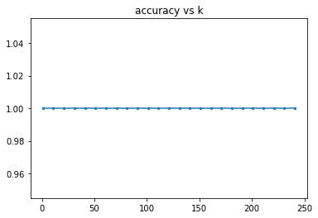
KNN- small subset with 5000 observation and 100 features
Since the dataset is too large, I made a smaller set to see the pattern of the best K: By using the Cross Validation, the degree of k from 1 to 250 has the same result which seems useless to our data. So I test some k for our model.
Notes:
I tried KNN. I tried to use Cross validation to find the best K from 1 to 250, but it runs very slow. So I tried to grab a small data set to see the pattern of how different degrees of k influence the accuracy, but from the graph it doesn't work well, the degree of k from 1 to 250 has the same result. So I test some k for our model.

Slide 21
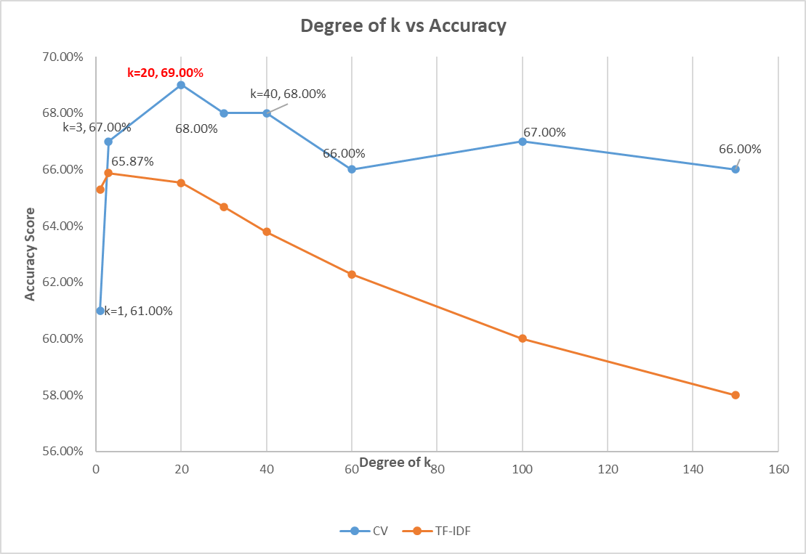
K-Nearest Neighbour
The best k is 20 and the accuracy rate is 69% with CV. Since the dataset is very large, and the accuracy of knn given k=20 is lower than Naive Bayes method, it seems knn is not a good method for this analysis.

Slide 22
Classification & Regression Trees (CART)
Chaing minimum number of points per leave can improve model (below is using CV method):
The accuracy of Max depth=5 tree is 55%.
The accuracy of Max depth=10 tree is 57%.
The accuracy of Minimum number of points per leaf= 2000 tree is 60%.
The accuracy of Minimum number of points per leaf= 1000 tree is 62%.
The accuracy of Minimum number of points per leaf= 500 tree is 65%.
The accuracy of Minimum number of points per leaf= 100 tree is 70%
Notes:
When the Minimum number of points per leaf decrease, the accuracy increase

Slide 23
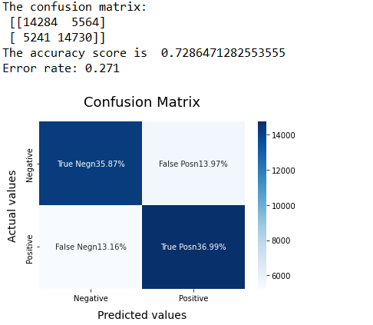
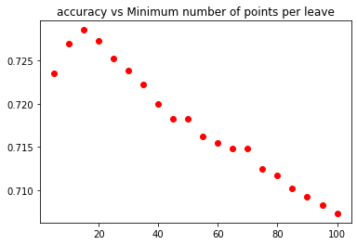
CART
The best tree model is when the minimum number of points per leaf= 15, the accuracy rate is around 72.86% with CV.
Below graph is accuracy vs minimum number of point per leaf from 5 to 100 jumping every 5 values:
The best tree of TF-IDF is when minimum number of points per leaf =35, score=72.2%
Notes:
graph the accuracy of minimum number of point per leave from 5-100

Slide 24
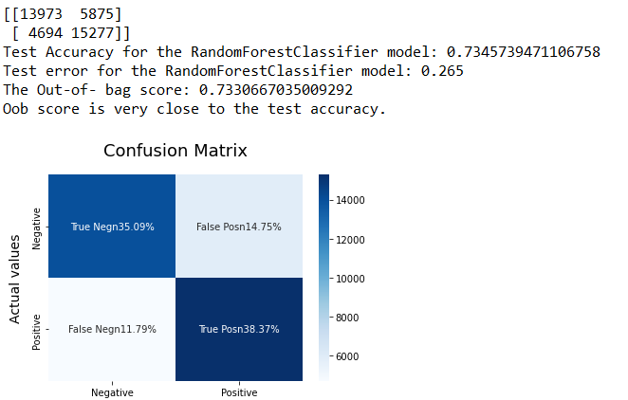
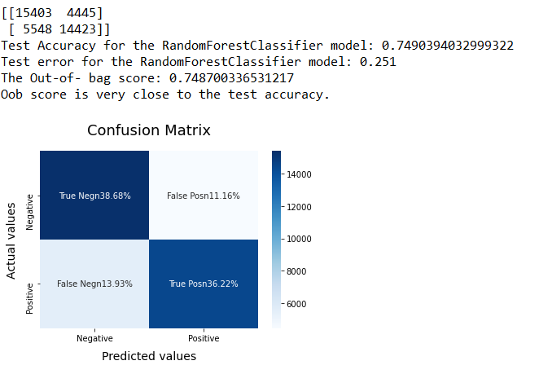
Random Forest
The random forest given number of estimators 500, and with minimum number items per leaf equal to 20 has an accuracy around 73.4% (CV).
The random forest given number of estimators 500, and with minimum number items per leaf equal to 20 has an accuracy around 74.88% (TF-IDF).

Slide 25
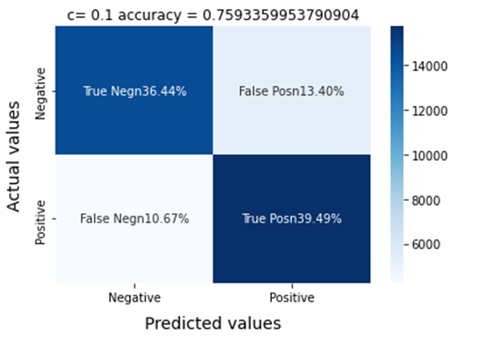
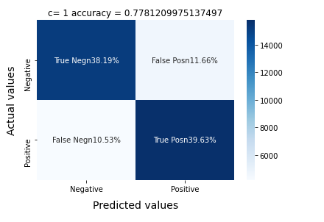
Logistic Regression without PCA
L2 regularization with the SAG optimization method:
c = [0.0001,0.001,0.01,0.1,1,10,100]
CV result:
The accuracy rate of each c is
[0.7171, 0.7334, 0.7529, 0.7593, 0.7589, 0.7587, 0.7587]
The highest accuracy is 0.7593 when c= 0.1.
TF-IDF result:
The accuracy rate of each c is[0.7385, 0.7413, 0.7615, 0.7772, 0.7781, 0.7769, 0.7768]
The highest accuracy is 0.7781 when c= 1 .

Slide 26
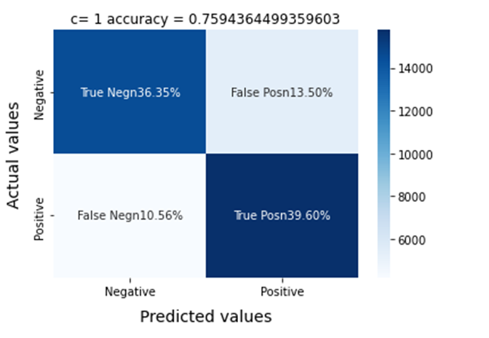
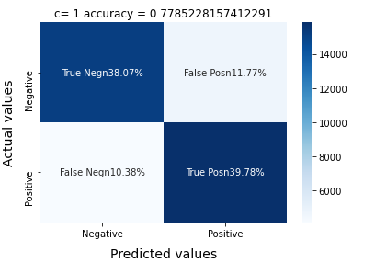
Logistic Regression without PCA
L1 lasso regularization with SAGA optimization method.
c = [0.0001,0.001,0.01,0.1,1,10,100]
CV result:
The accuracy rate of each c is[0.5015, 0.5509, 0.6938, 0.7545, 0.7594, 0.7590, 0.7589]
The highest accuracy is 0.7594 when c= 1.
TF-IDF result:
The accuracy rate of each c is[0.4985, 0.5015, 0.6807, 0.7648, 0.7785, 0.7770, 0.7767]
The highest accuracy is 0.7785 when c= 1 .

Slide 27
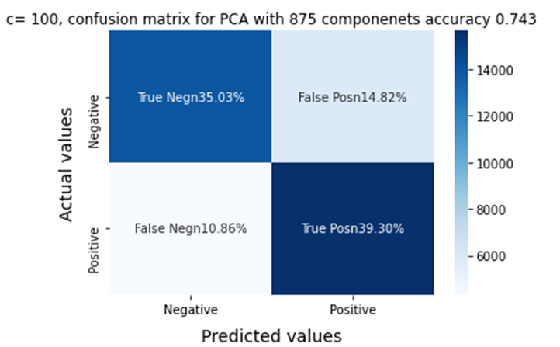
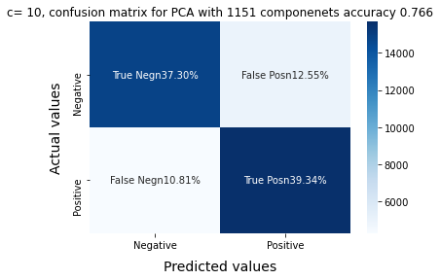
Logistic Regression with PCA
L2 regularization with the SAG optimization method:
c = [0.0001,0.001,0.01,0.1,1,10,100]
CV result:
PCA reduced 2500 features to 1151 features.
The accuracy rate of each c is [0.7128, 0.7249, 0.7402, 0.7426, 0.7430, 0.7432, 0.7432]
The highest accuracy is 0.7432 when c= 100.
TF-IDF result :
PCA reduced 2500 features to 1151 features.
Accuracy rate of each c is[0.7351, 0.7386, 0.7563, 0.7649, 0.7663, 0.7664, 0.7498]
The highest accuracy is 0.7664 when c= 10 .

Slide 28
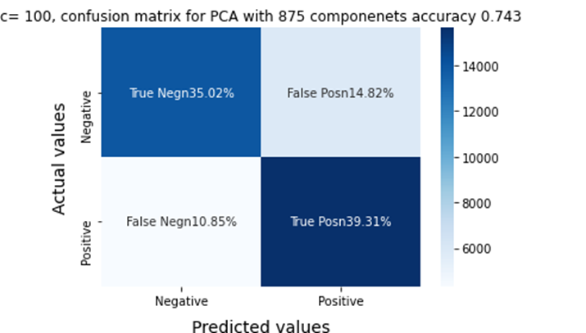
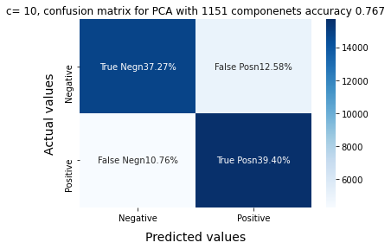
Logistic Regression with PCA
L1 lasso regularization with SAGA optimization method.
c = [0.0001,0.001,0.01,0.1,1,10,100]
CV result:
The accuracy rate of each c is[0.4985, 0.6240, 0.7023, 0.7418, 0.7426, 0.7432, 0.7433]
The highest accuracy is 0.7433 when c= 100.
TF-IDF result:
The accuracy rate of each c is[0.4985, 0.6346, 0.7025, 0.7575, 0.7665, 0.7667, 0.7662]
The highest accuracy is 0.7667 when c= 10 .

Slide 29
Logistic Regression Results
The best result is using L1 lasso regularization with SAGA optimization method before
PCA and using TF-idf representation. The accuracy rate is 77.85%, when c =1, which is slightly higher than L2 SAG, accuracy is 77.81% when c= 1.
PCA doesn’t work well for the linear logistic regression model.
It costs too high (memory error) for polynomial logistic regression model, will try this using Neural Network (I tried SVM, but still too slow).
PCA doesn't work for NB, as the Naive Bayes classifier needs discrete-valued features, but the PCA breaks this property of the features.
Notes:
L1 works better than L2, It is more suitable for our situation because L1 Lasso shrinks the less important feature’s coefficient to zero thus, removing some feature altogether. In our context, if the word is totally meaningless, L1 will delete that feature, not like L2 given some weight.

Slide 30
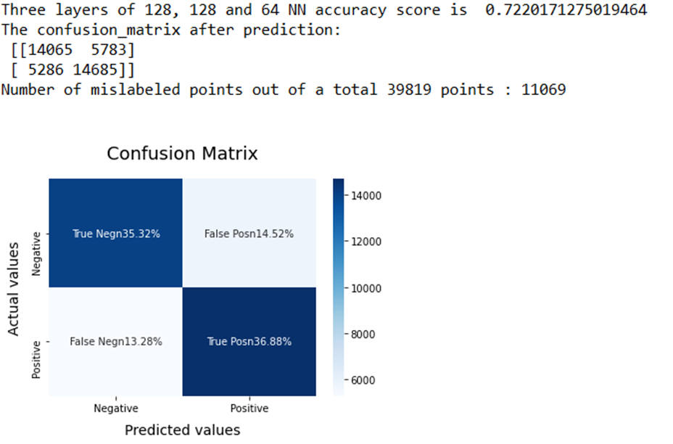
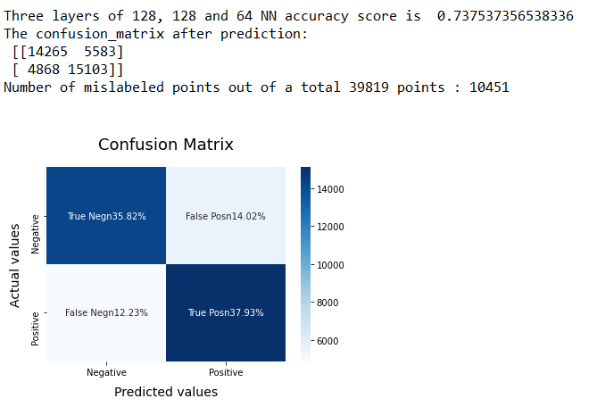
Neural Network without PCA
CV Three layers of 128, 128, 64 without PCA:
TF-IDF Three layers of 128, 128, 64 without PCA:

Slide 31
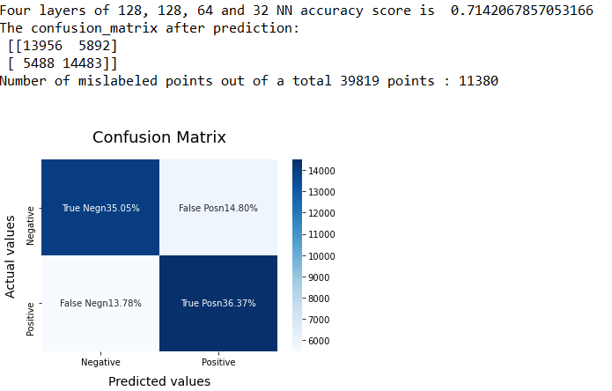
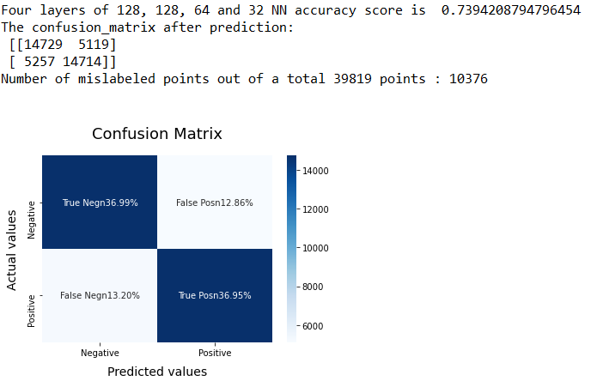
Neural Network without PCA
CV Four layers of 128, 128, 64, 32 without PCA:
TF-IDF Four layers of 128, 128, 64, 32 without PCA:
Notes:
TF works better than CV

Slide 32
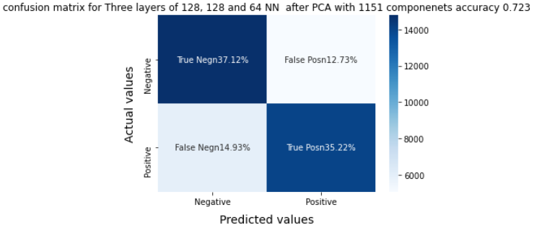
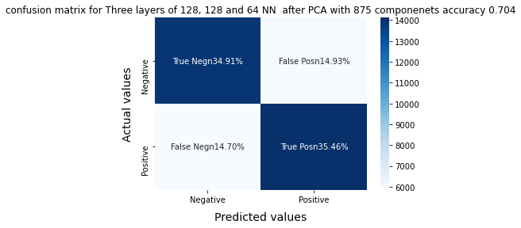
Neural Network with PCA
TF-IDF Three layers of 128, 128, 64 with PCA: The accuracy score is = 0.7234
CV Three layers of 128, 128, 64 with PCA: The accuracy score is = 0.7037

Slide 33
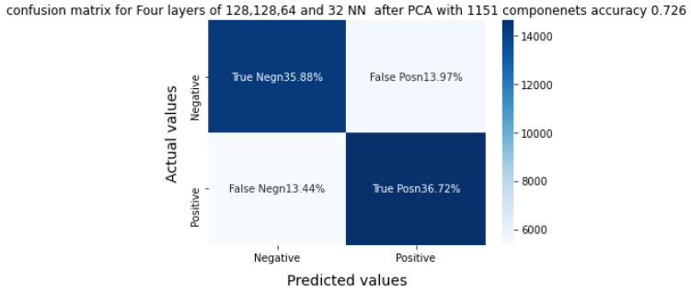
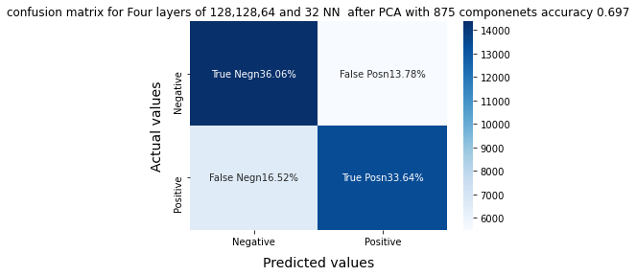
Neural Network with PCA
TF-IDF Four layers of 128, 128, 64, 32 with PCA: The accuracy score is =0.7260
CV Four layers of 128, 128, 64, 32 with PCA: The accuracy score is = 0.6970

Slide 34
Conclusion
The best model is L1 lasso regularization with SAGA optimization method before PCA using TF-IDF feature extraction model, the accuracy rate is 77.85%, when c =1, followed by L2 SAG PCA using TF-idf, accuracy is 77.81% when c= 1. This is an improvement to our baseline Bernoulli NB model which is 76.67%.
TF-IDF feature extraction performed better than CV feature extraction to most of the models I have applied.
PCA does not work well to this project.
KNN does not work well to this project.
I can try to increase feature size to improve the performance.
Notes:
L1 works better than L2, It is more suitable for our situation because L1 Lasso shrinks the less important feature’s coefficient to zero thus, removing some feature altogether. In our context, if the word is totally meaningless, L1 will delete that feature, not like L2 given some weight.
PCA finds a lower dimensional representation of the data that minimizes the squared reconstruction error. If the data has irrelevant features (often the case in text classification), PCA counts errors in those with equal importance as errors in words that are important for our classification. PCA removes variability without knowledge of the variables that are most useful in classification, can hurt the result.

Slide 35
Thank you!

